Slide 1
Determining 311 usage levels with socio-economic and spatial features
NYU CUSP CENTER
Juan Mora, Diego Garzon, Nikhil Kishore, Yanchao Xu

Slide 2
Agenda
Project overview
Motivation and objectives
Methodology
Sample results
Limitations and conclusions

Slide 3
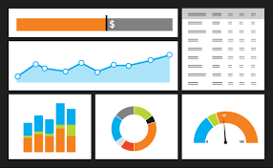




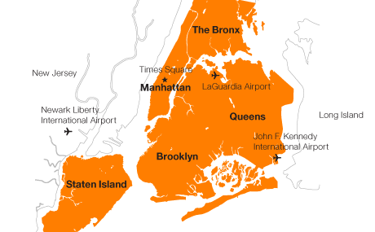



Overview of the project
Service requests
….
….
Notes:
The main purpose of this project was to create an analytical model designed to provide insights on whether correlations between socio economic features of both residents and incoming workers for defined New York City geographical areas, and the number and types of service requests received by 311 on the same areas existed.

Slide 4
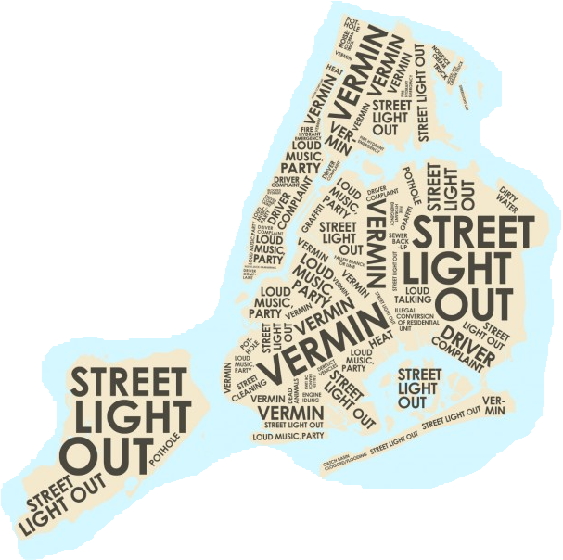
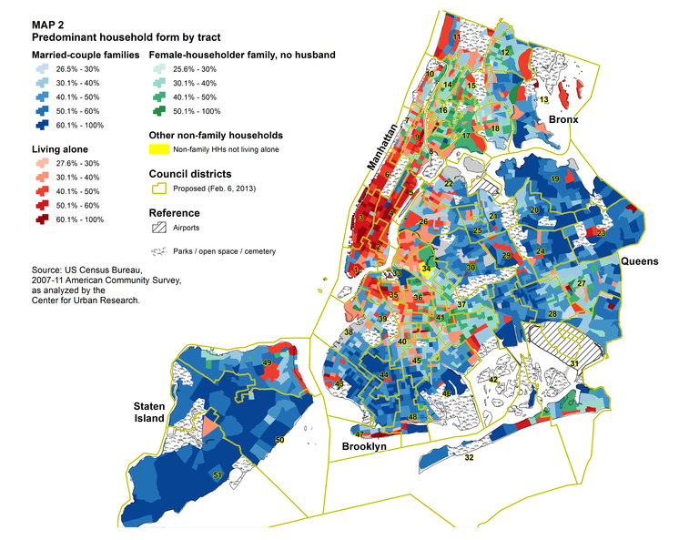

Motivation
Are the number and types of 311 service requests related to socio economic and neighborhood caracteristics in NYC? Can they be used to determine propensities to report this requests?
Notes:
Are complaints received by 311 strongly correlated with socioeconomic factors? If that’s the case, in what measure?
Based on the answer to this question, is there a way to create a forecasting model that would help 311 to make future decisions?.

Slide 5
Objectives
Using a set of demographic and spatial features, create an analytical model to determine existing relations between certain types of caracteristics and types of 311 service requests.
Identify groups of 311 “User profiles” based on demographics, to validate the levels of coverage.
Provide an interactive visualization tool to assess the inputs and results of the analytical model in an intuitive form.

Slide 6




Data Sources

Slide 7
Methodology
Aggregate data (Features and service requests).
Quantify the impact of socio demographic indicators.
Analyze statistical error (difference between estimated values and observed, ground-truth values for each type of requests).
Quantify the impact of neighborhood features (residential and commercial areas, number of cars, population density, etc.).
Create a robust model combining findings of steps 2 and 4.

Slide 8
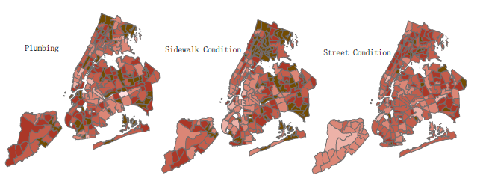
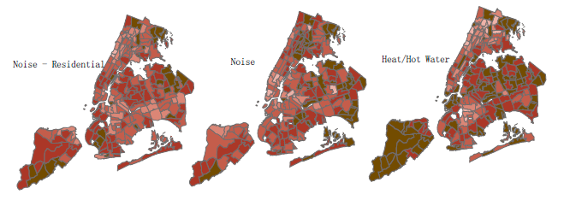
Mapping of the statistical error for selected types of service requests

Slide 9
Spatial features included in the second iteration of the model
Population density (defined as total population divided by total land area).
Proportion of build up areas (Residential, commercial, office and retail) on total build up area.
Median House Value, median age, median rent (for tenants), median income.
Total number of cars, normalized by total population (per capita).

Slide 10
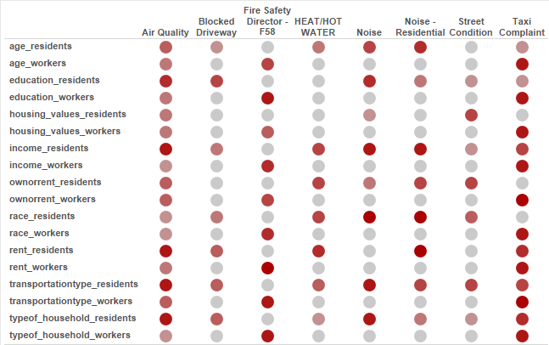

Explanatory capacity of demographic features on selected service requests

Slide 11
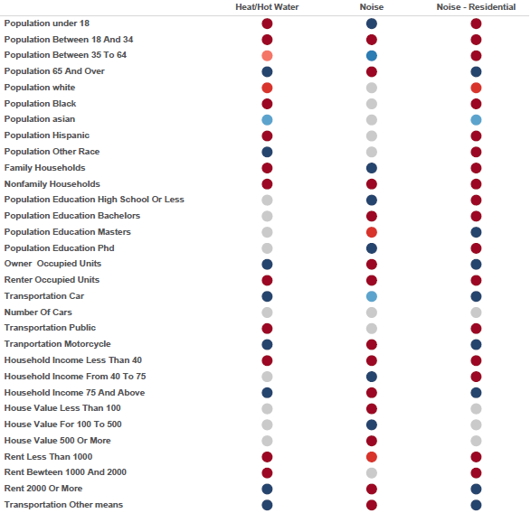
Particular relation between demographic features and selected service requests (Only for residents)

Slide 12
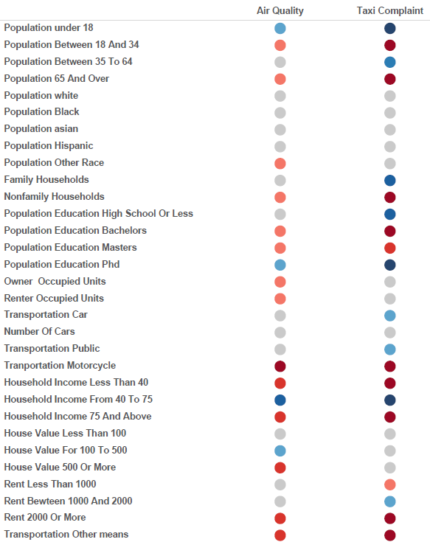
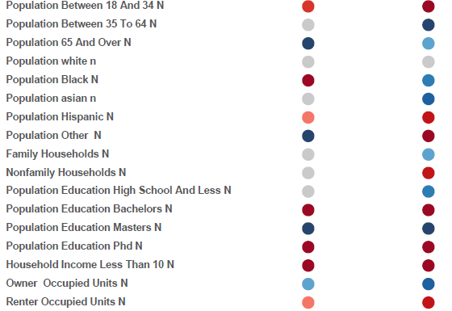
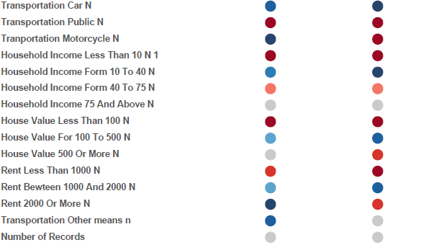
Particular relation between demographic features and selected service requests (both form residents and workers)

Slide 13
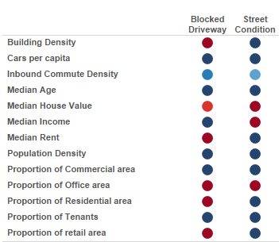

Particular relation between spatial features and selected service requests

Slide 14
Possible limitations
Service requests are not entirely correlated to real-world problems.
Service requests could include some levels of skewness in defined geographical areas.
311 service request data could include bias because it’s related to human behaviour.
There is a large number of commuting population working in the city making service requests.
The model does not account for overlapping of certain socio economic features.

Slide 15
Deliverable 2: Visualization Tool
http://nk1877.github.io/Capstone/prototype/#

Slide 16
Conclusions
Neighborhood tabluation areas (NTA) displayed the best results (explanatory capacity and correlation) in terms of geographical aggregation.
The final analytical model showed statistically significant results, both in terms of explanatory capacity for selected demographic and spatial features, as well as user profile creation.
Demographic characteristics of people largely affect their service request behavior while at home or at work; spatial features affect them too, but only on selected types of requests.
The resident population group showed better results (in terms of high explanatory levels) when compared to the incoming working group.

Slide 17
Conclusions (Cont.)
5) The results of the model can be used by 311 in order to better understand their levels of global service in the City and how it can improve the coverage of various demographic groups and neighborhoods
6) The results of this project could also be used by urban stakeholder (from concerned citizens to allied agencies) to better understand how 311 service request statistics should be interpreted in order to reveal actual functional and socio-economic context of the local neighborhoods.
6) Due to the large quantity of the results, as well as the potential to extend the application of the designed methodology and analytical model to 311 historical data, it is highly recommended that the work initiated with this project is continued in the near future jointly by CUSP and 311.

Slide 18
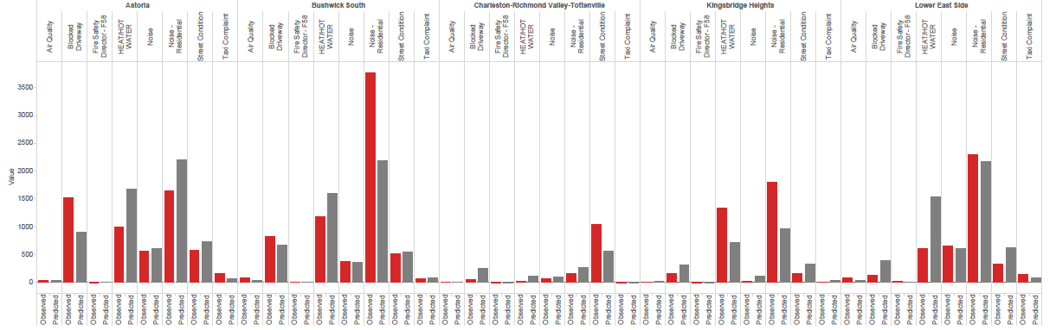

Observed and predicted values per types of complaints on selected NTA’s using only socio economic and demographic features

Slide 19
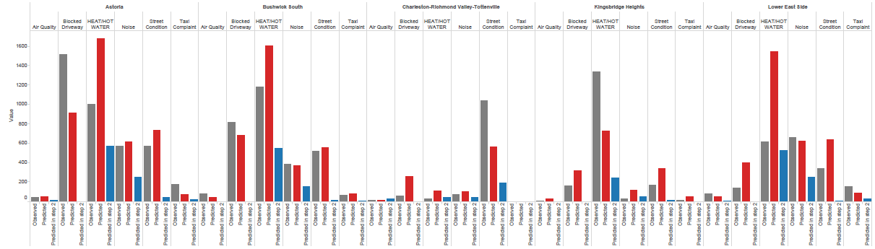

Observed and predicted values per types of complaints on selected NTA’s using all features (including spatial)

